Slide 1
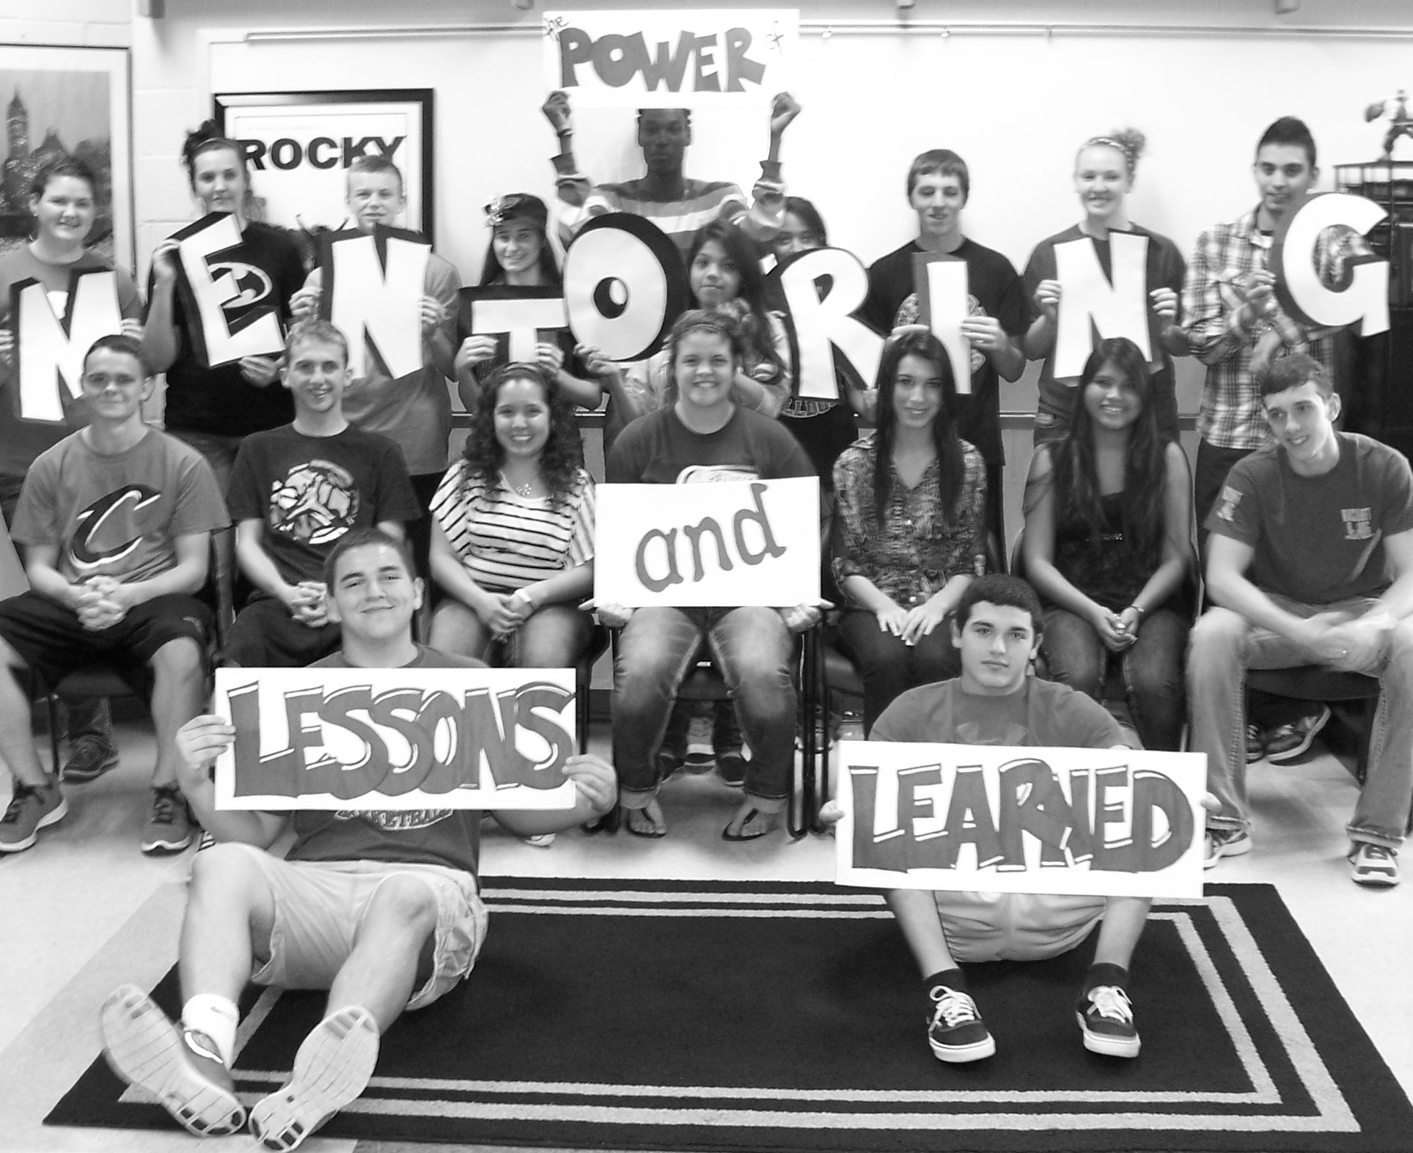
The POWER of

Slide 2
Central ISD East Texas GEAR UP Project
Approximately 1543 students
57% of district population are Low SES
76% of GEAR UP cohort are Low SES (9th grade)
Mentoring program driven by the needs of students rather than the expectations of adults
Program consists of one-to-one mentors, classroom mentors, small group mentors, student lab mentors, and mentors who serve within the community.
Partnered with Stephen F. Austin State University

Slide 3
Mentoring Program Players
Facilitator - “knows” students, organized,
matches students, builds positive relationships with students, teachers and staff
Teachers - aware of program goals, make student referrals, work with and for mentors/mentees
Mentors - trustworthy, diligent, nonjudgmental, genuinely concerned, patient
Mentees/Parents – those with a positive perception about mentor relationships and purpose earn higher grades, are absent less often, and have fewer discipline issues

Slide 4
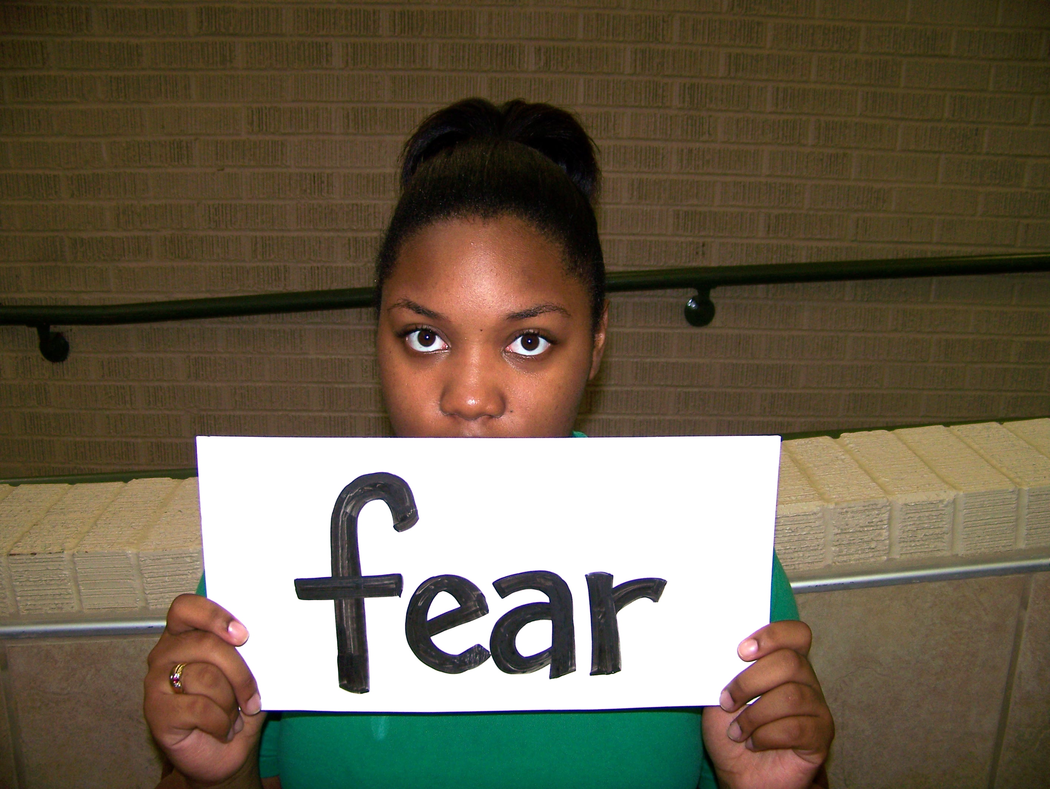
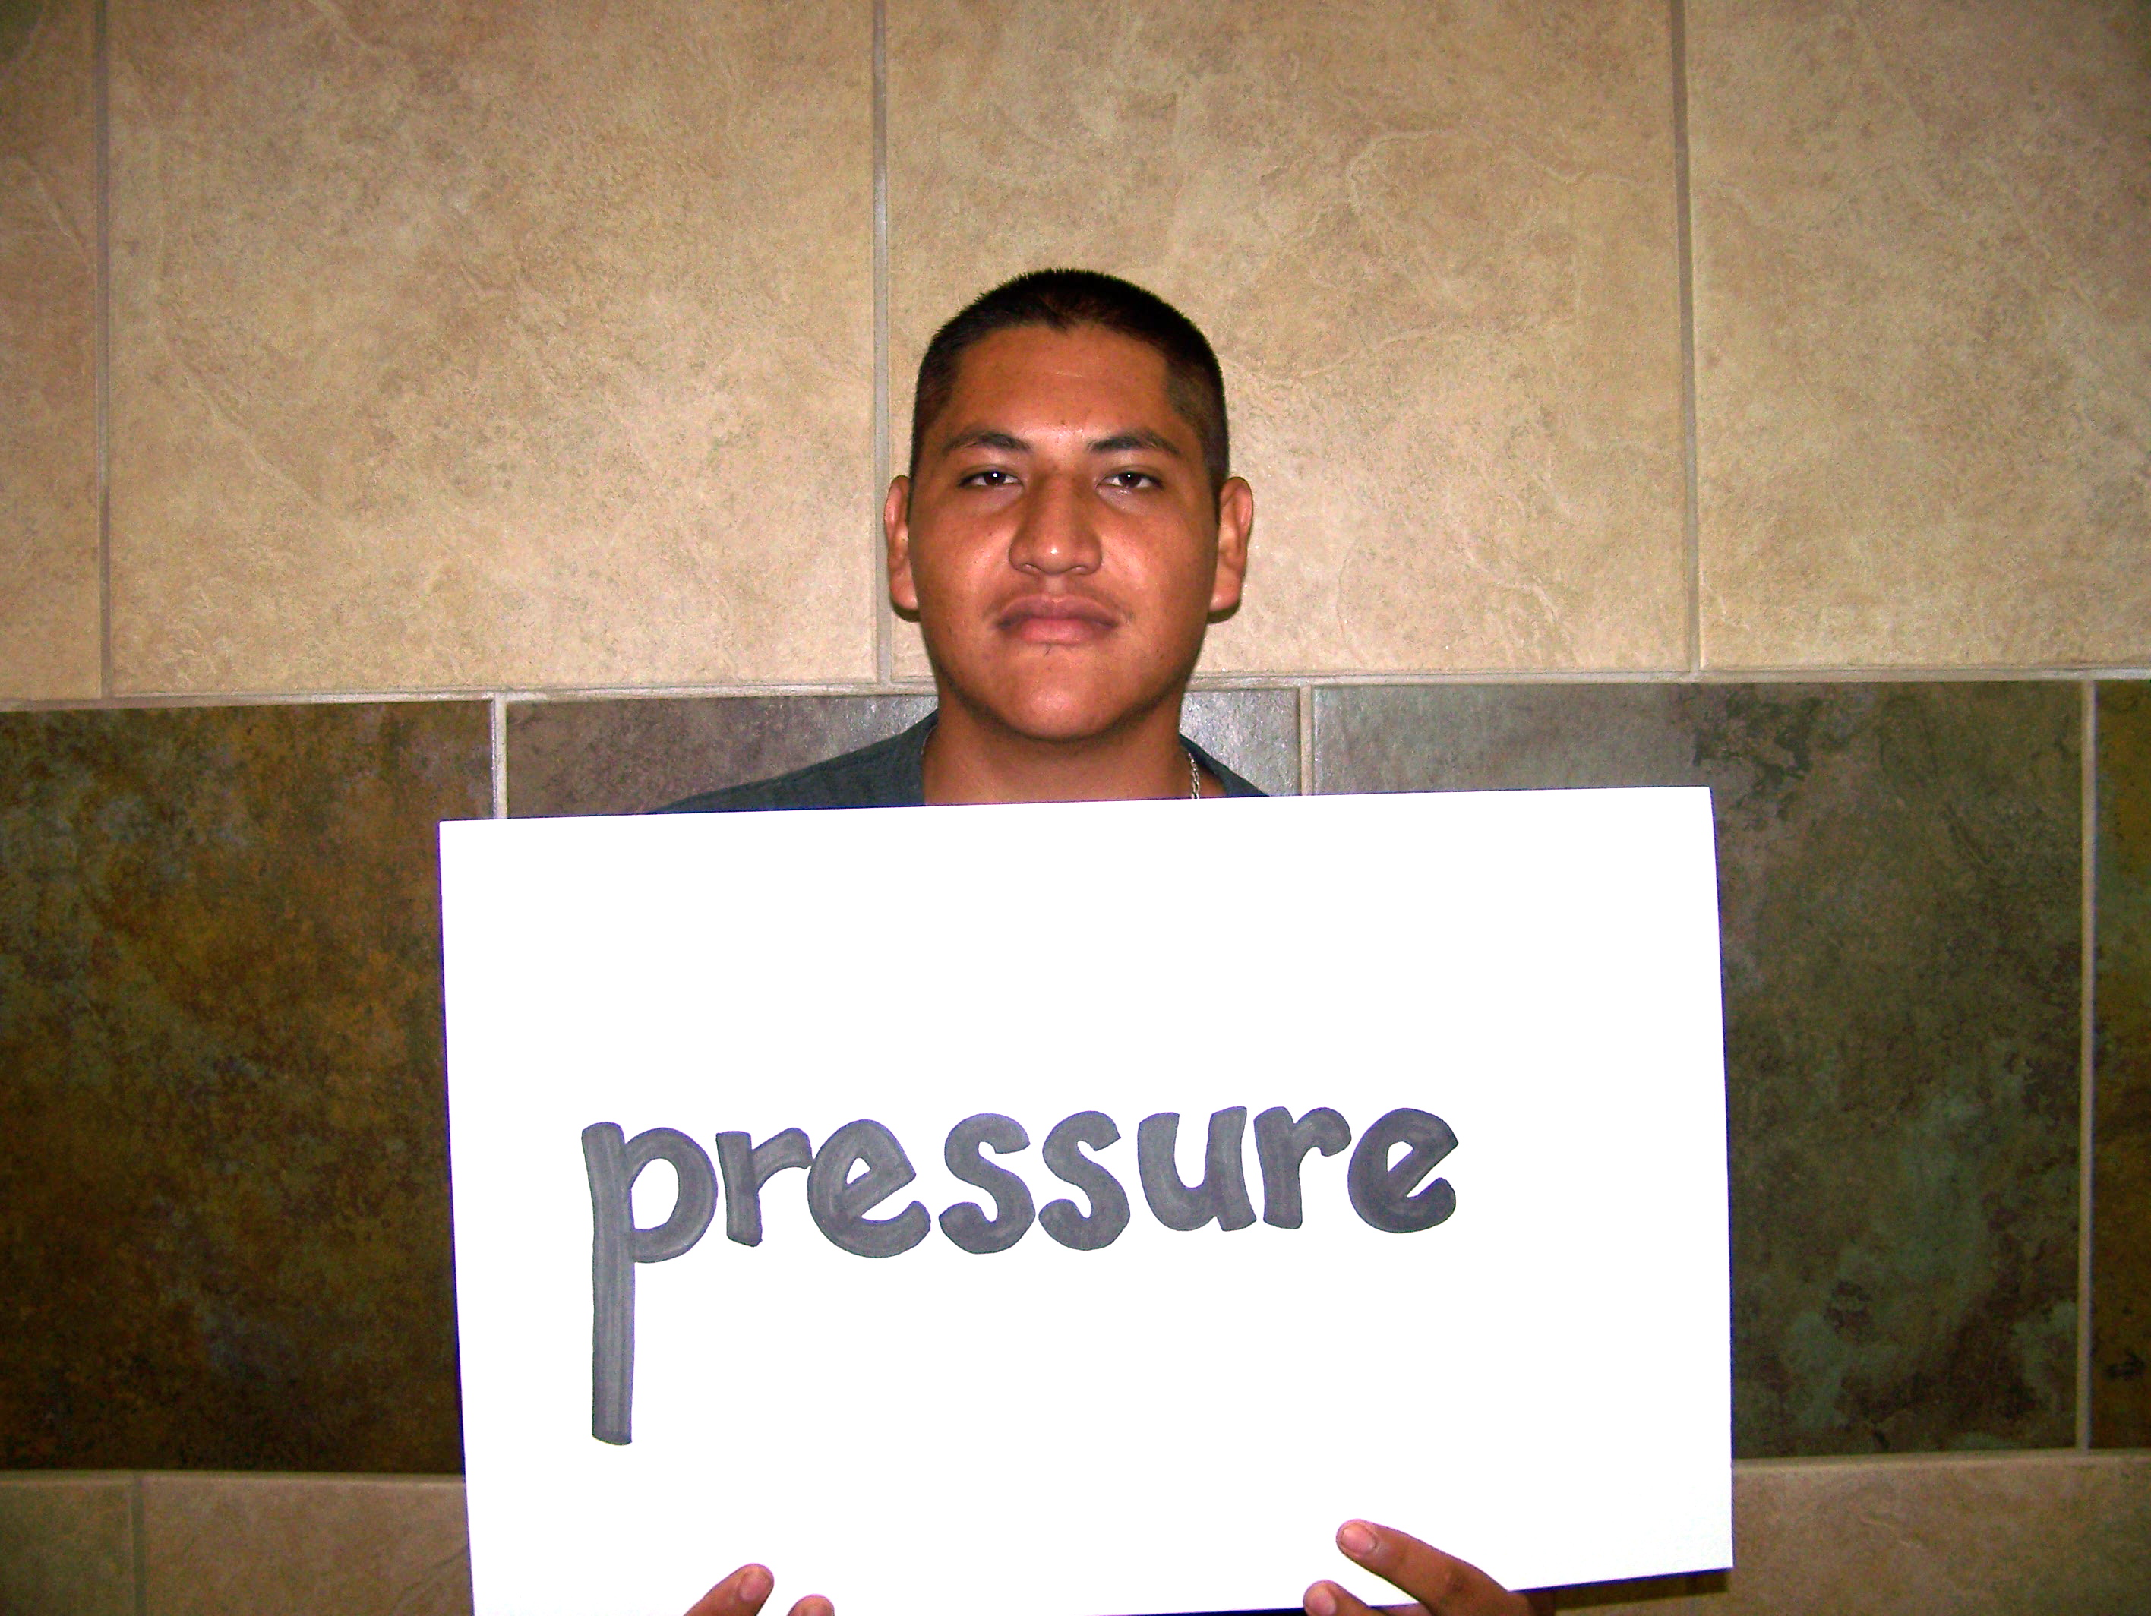
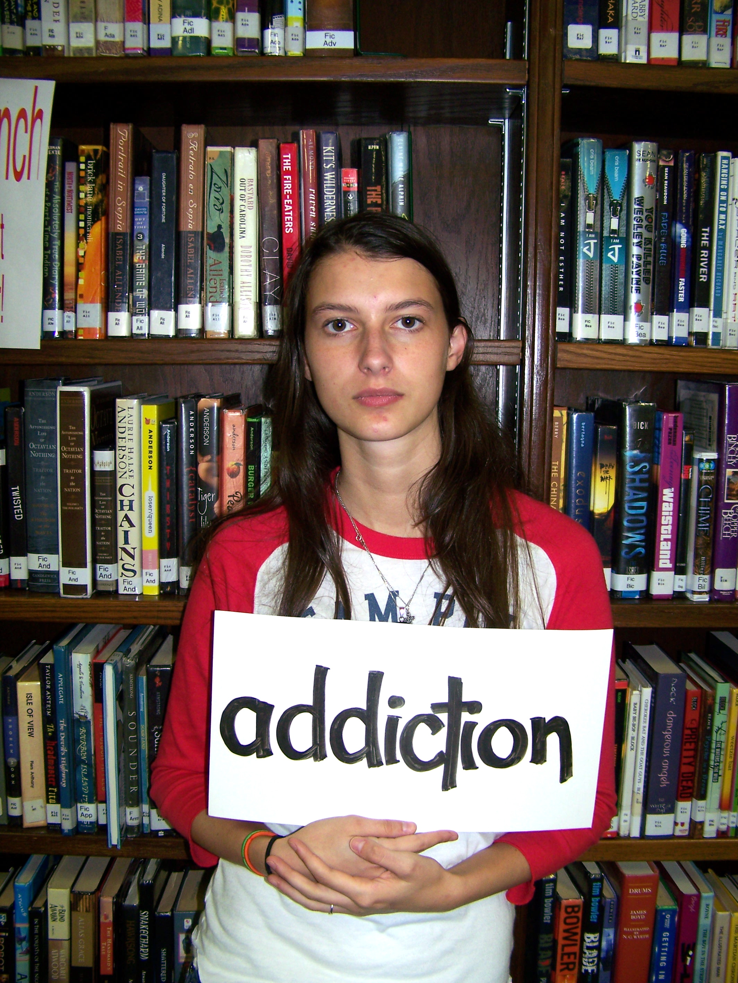
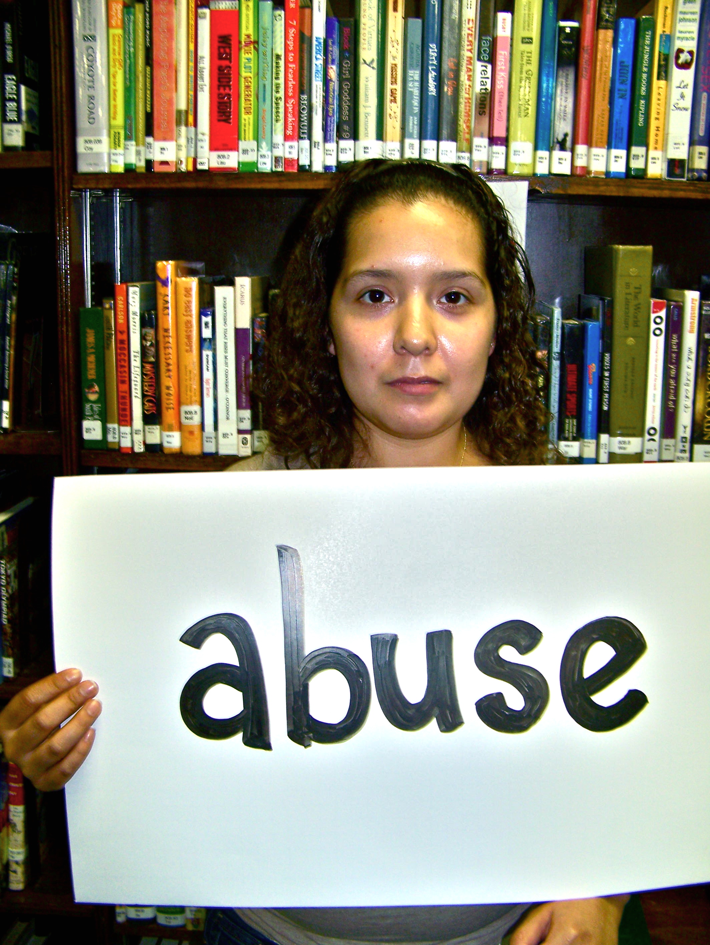
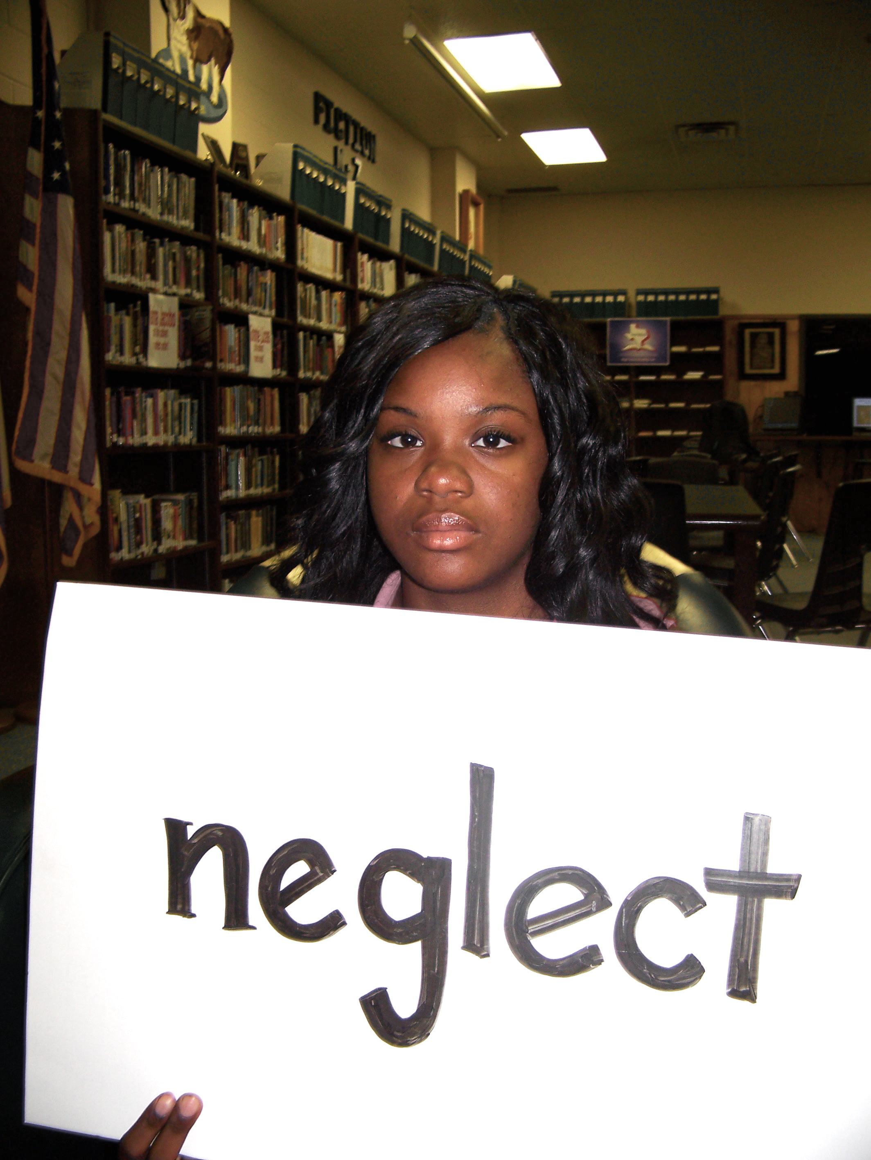
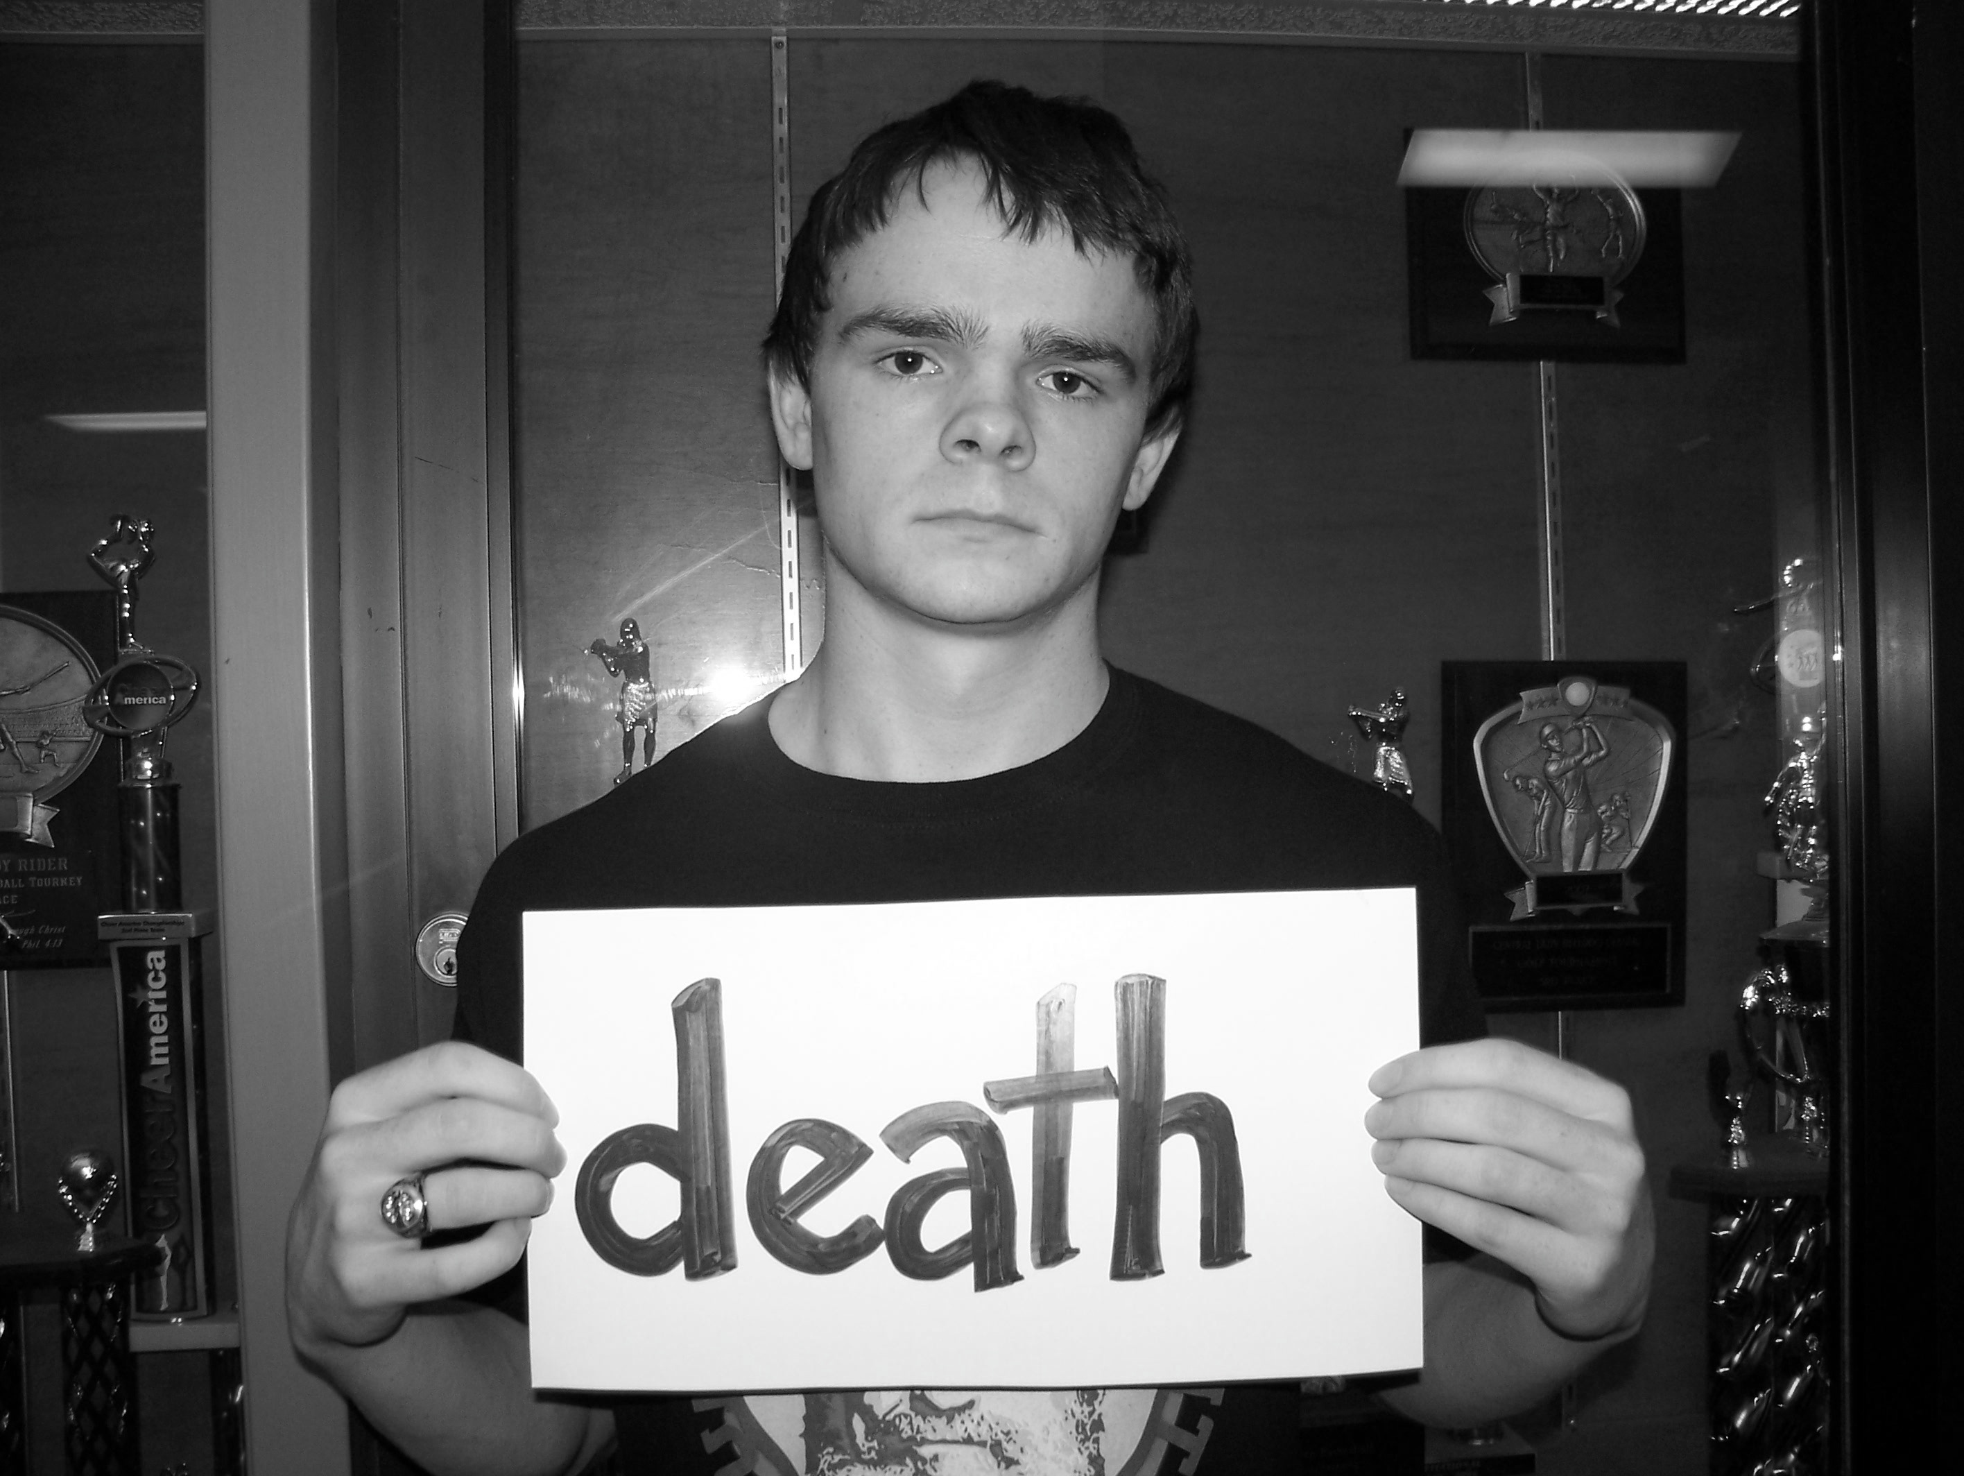
MENTORS NEEDED So many obstacles…

Slide 5
Mentoring Motivates
Provides unconditional acceptance and support
Our mentor numbers: (each served a minimum of 5 months)
In 2010-12, 22 mentors served
In 2011-12, 57 mentors served
In 2012-13, 71 mentors served
Numbers at end of first nine weeks 2013-14 = 39
We have a waiting list of high school students who want to
participate and become mentors. This has had a huge impact
upon the mindset of our campus and student body.
“Students who --- have someone in their lives who cares about them, encourage
their development, and are good role models for them --- have the best chance
of growing up to become responsible, productive, caring adults themselves.”
(Jekielek. Mentoring: A Promising Strategy for Youth Development, 2012.)

Slide 6
Maslow’s Theory of Motivation

Slide 7
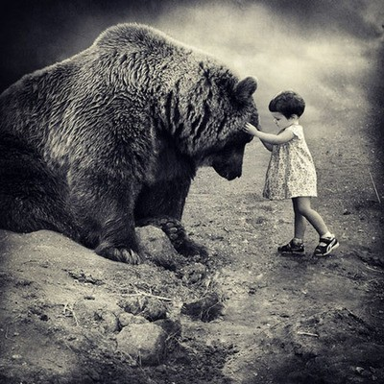
PRIVILEGE WALK

Slide 8
Outcomes
I. Educational Achievement
A. better attendance and fewer unexcused absences
B. better attitude toward school than non-mentored youth
C. grades improve
D. increased chance of continuing on to higher education
II. Health and Safety (substance use and delinquent behavior)
A. 70% less likely to initiate drug or alcohol use (Jekielek 2012).
B. evidence of reducing some, but not all, negative behaviors
C. many mentees specifically avoid “problem” behavior in order to participate in program and keep his or her mentor
III. Social and Emotional Development
A. promotes positive social attitudes and relationships
B. improved communication skills
C. Mentor relationships do not consistently improve young people’s perceptions of their worth. However, there is an indirect result that occurs when a student’s communication skills and grades improve.

Slide 9
CALEB’S STORY
Lesson Understanding
SELF
PURPOSE
and
VALUE

Slide 10
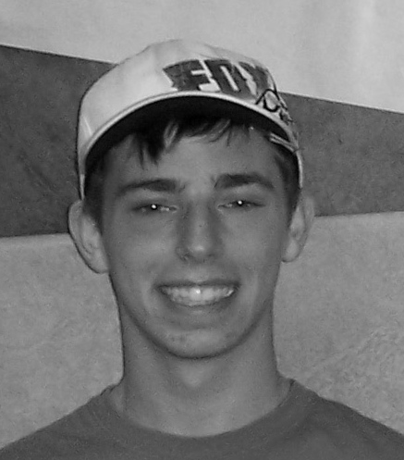
Lessons Learned
benefits peer mentor as much or more
helps mentee see life as a series of obstacles that can be overcome---not victim of circumstance
list of mentors wanting the opportunity is longer than mentees referred
little or no cost to operate
Funds to support and celebrate mentor/mentee accomplishments (would be nice!)
Mentees can become dependent
Teaching effective closure is difficult
Requires a great deal of time organizing/planning ((matching, monitoring, assessing effectiveness (not always measured in grades), etc.))

Slide 11
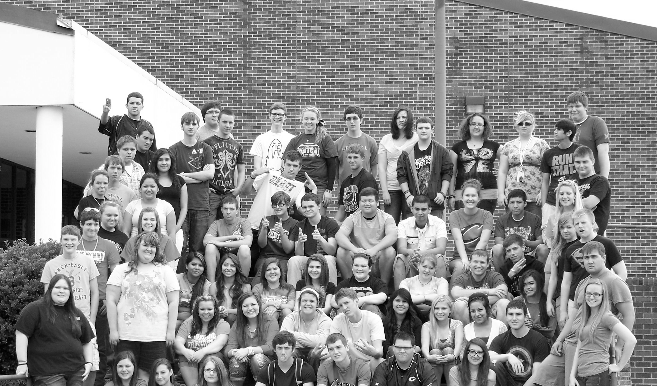
MENTOR VIDEO FOR 2012-13
Making a difference

Slide 12
Ideas
Create a mentoring period for high school juniors or seniors to receive local credit. Five to 8 students maximum (or dependent upon your student population). With this group you can accomplish many things. (i.e. assign struggling students different days of the week to a mentor, create a lab that period for any students to come to receive academic assistance as needed, mentors can be available that period to classroom teachers who need help with small groups or projects, or assign individual students to a mentor for social/emotional support).
If have tutorial period or homeroom, have students who need a mentor, academic help, etc. come to a designated room/area and partner with mentors you have assigned to receive academic assistance or just a support system for challenges he or she may be facing.
Find elective subject teachers who are willing to work with mentor schedules in order to allow mentors time during class one or two days a week to work with his or her mentee.
Find community service based groups (i.e. National Honor Society, TAFE, etc.) who will begin an after school program that has mentors available for different reasons.

Slide 13
Suggestions
Need structure and planning to facilitate high levels of interaction between youth and their mentors. (The mentors handle the hard part. Facilitator makes sure there is a consistent system that provides both mentors and mentees with the opportunity to meet and work together.)
Be consistent. The longer the relationship has to build, the better the outcome. Goes beyond recruiting and matching---giving opportunity to maintain enthusiasm long enough to benefit.
Student perception is huge. If they look at it as a cool thing that could help them with different “stuff,” they will be more likely to head in a positive direction.
Most at risk benefit most. Do not call them out and tell them they need help and you are assigning them to someone. Look at their grades first. Examine subjects in which they are struggling. Ask them if they would consider helping some high school mentors who need community service hours. Explain that the mentor’s job is to work with a younger student who is having a little trouble in a subject. All they have to do is give them a chance to see if they like it. Most readily agree, especially when they know they get to work with an older kid who will give them all of their attention. If they don’t, try a different angle or wait a week or so. If a kid is not willing, it does not matter how great the mentor is; It will not work.

Slide 14
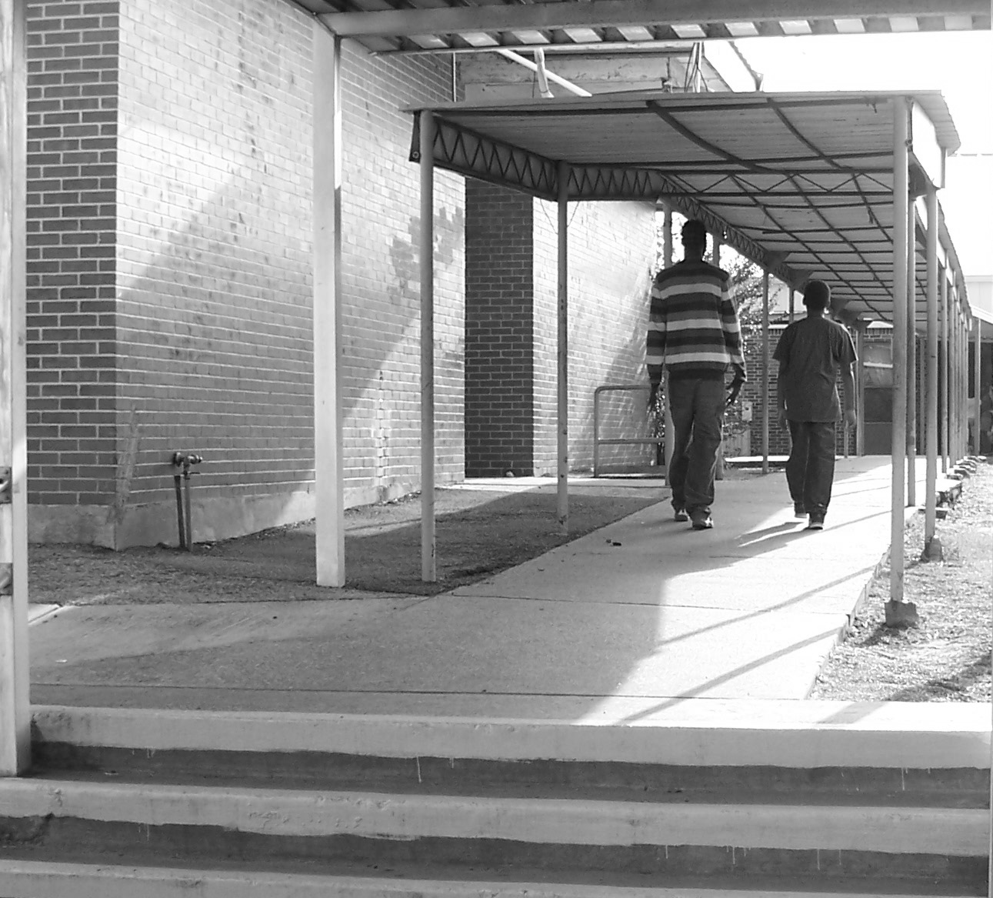
Thank
You
For
Coming!
“No man is capable of self-improvement
if he sees no other model but himself.”
-Conrado Generoso

Slide 15
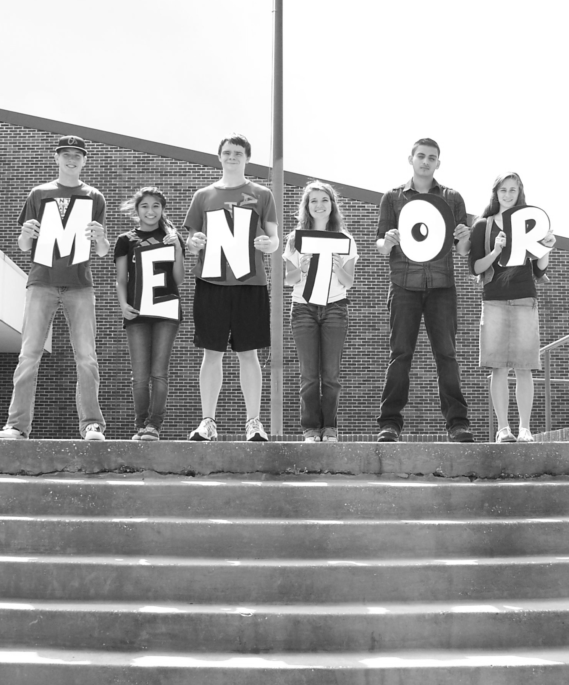
Contact Info.
Sandy Flowers
GEAR UP Coordinator
Associate Principal
936.853.2167 flowerss@centralisd.com
Richard Nash
High School Principal
936.853.2169 nashr@centralisd.com
Don Allen
District Curriculum Director
936.853.9312 allendon@centralisd.com
Maria Plotts
Intervention Counselor
936.853.2167 plottsm@centralisd.com
We are the mirror
of our own
expectations

